Slide 1
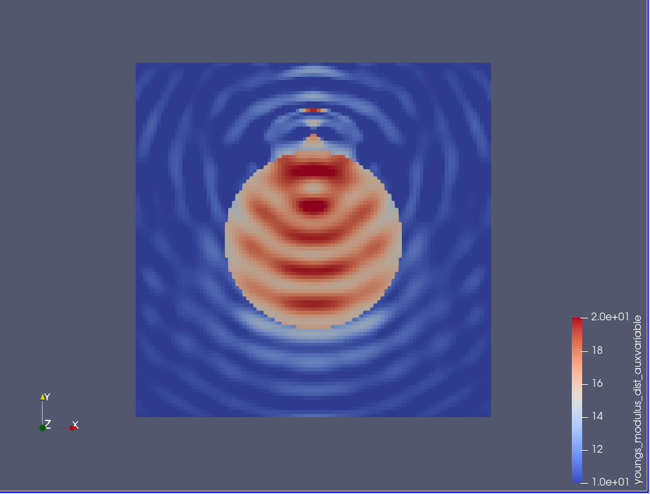
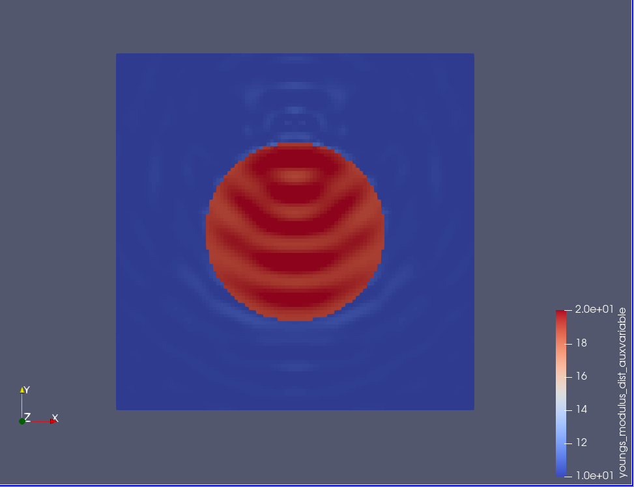
Input data
Compressible elastic wave equation
Ex.1-top
1 source @ (0.5,0.8)
Receivers: entire wavefield is considered.
1 freq @ (w=100 cycle)
E_matrix=10
E_inclusion=20
Initial_guess_inclusion=15
Diameter=0.5
Domain= 1x1
Mesh =100x100
Ex.1-bottom
Same input except Initial_guess_inclusion=19

Slide 2
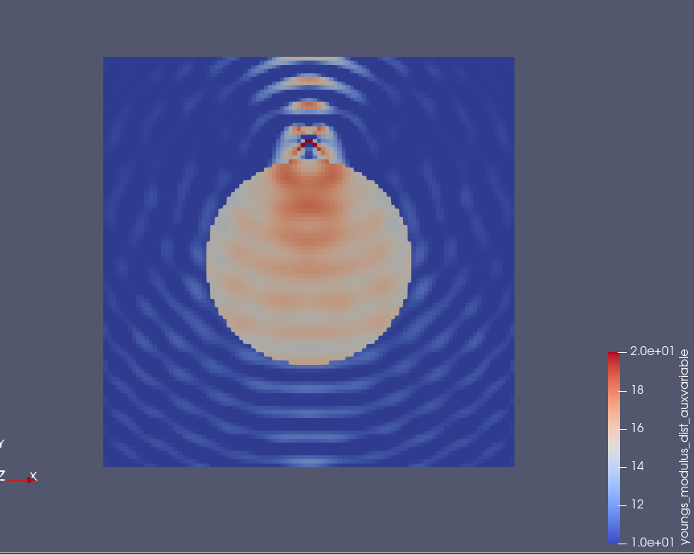
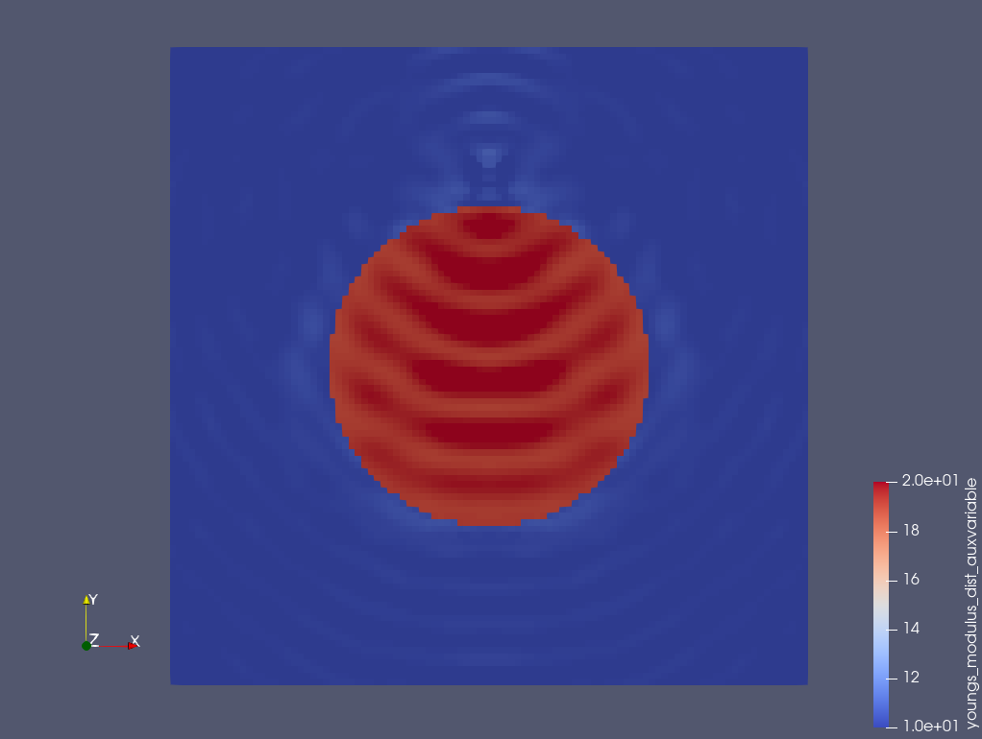
Parameters takes negative/very small values in the inversion process.
Input data
Incompressible elastic wave equation
Ex.1-top
1 source @ (0.5,0.8)
Receivers: entire wavefield is considered.
1 freq @ (w=100 cycle)
E_matrix=10
E_inclusion=20
Initial_guess_inclusion=15
Diameter=0.5
Domain= 1x1
Mesh =100x100
Ex.1-bottom
Same input except Initial_guess_inclusion=19

Slide 3
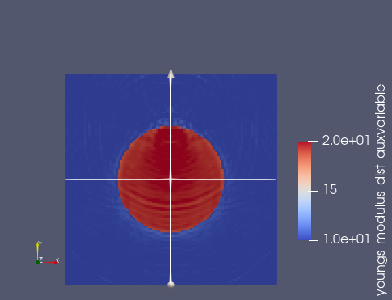
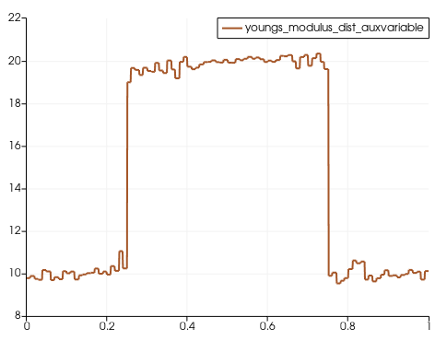
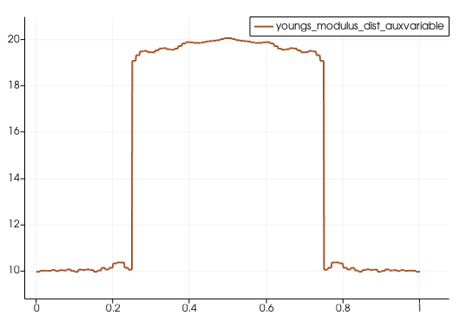
Input data
Incompressible elastic wave equation
1 source @ (0.5,0.8)
Receivers: entire wavefield is considered.
11 freq @ (w=100-300@20 cycle)
E_matrix=10
E_inclusion=20
Initial_guess_inclusion=19
Diameter=0.5
Domain= 1x1
Mesh =100x100
Section 1
Section 2
L2 norm – misfit function is used
Section 2
Section 1

Slide 4
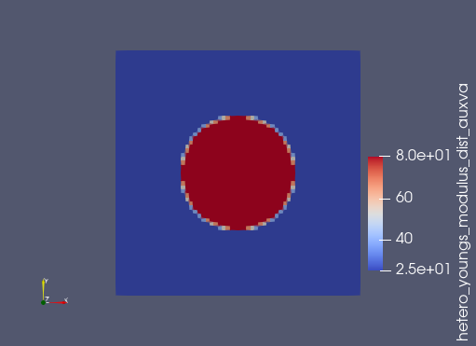
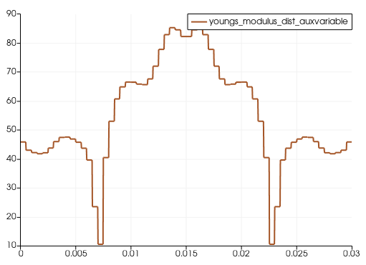
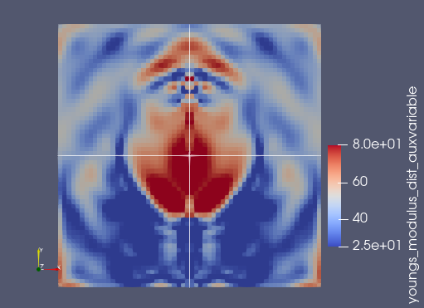
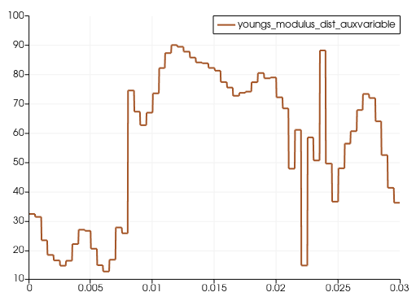
Input data
Incompressible elastic wave equation
1 source @ (0.015,0.024)
Receivers: 44 RCV@0.005.
51 freq @ (w=100-600@10 Hz)
E_matrix=25 kpa
E_inclusion=80 kpa
Initial_guess – was mistakenly set as homogenous=50 kpa
Diameter=0.014=14 mm
Domain= 0.03x0.03= 30 mmx30 mm
Mesh =60x60
Section 2
Section 1
Section 1
Cross-correlation function is used
Section 2

Slide 5
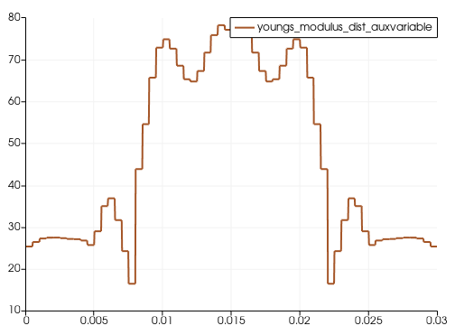
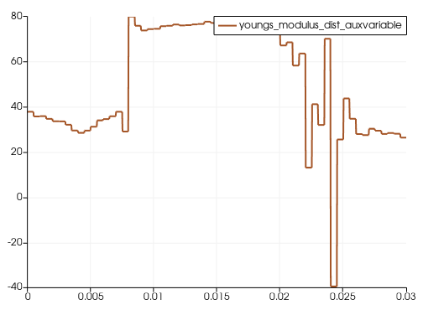
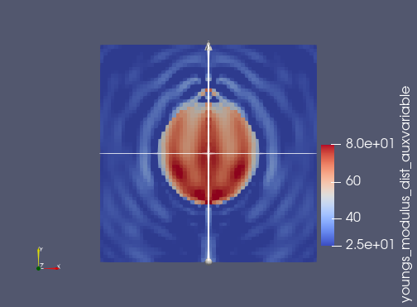
Input data
Incompressible elastic wave equation
1 source @ (0.015,0.024)
Receivers: 44 RCV@0.005.
51 freq @ (w=100-600@10 HZ)
E_matrix=25 kpa
E_inclusion=80 kpa
Initial_guess inclusion=50 kpa
Diameter=0.014=14 mm
Domain= 0.03x0.03= 30 mmx30 mm
Mesh =60x60
Section 2
Section 1
Cross-correlation function is used

Slide 6
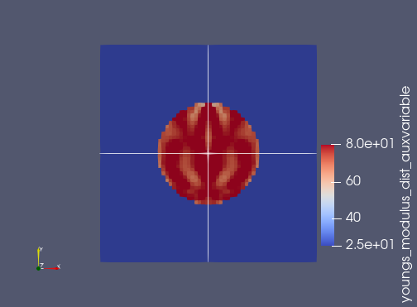
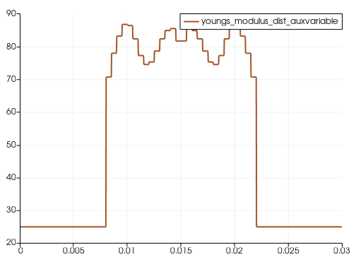
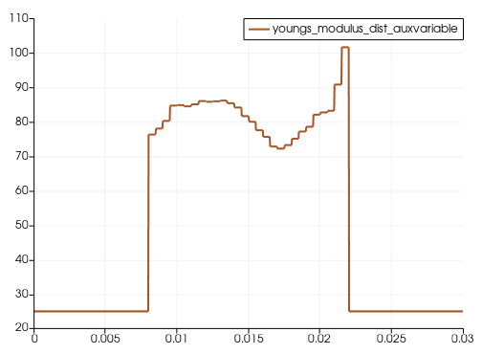
Input data
Incompressible elastic wave equation
1 source @ (0.015,0.024)
Receivers: 44 RCV@0.005.
11 freq @ (w=100-600@50 HZ)
E_matrix=25 kpa
E_inclusion=80 kpa
Initial_guess inclusion=50 kpa
Diameter=0.014=14 mm
Domain= 0.03x0.03= 30 mmx30 mm
Mesh =60x60
Section 2
Section 1
Section 1
Cross-correlation function is used
Section 2

Slide 7
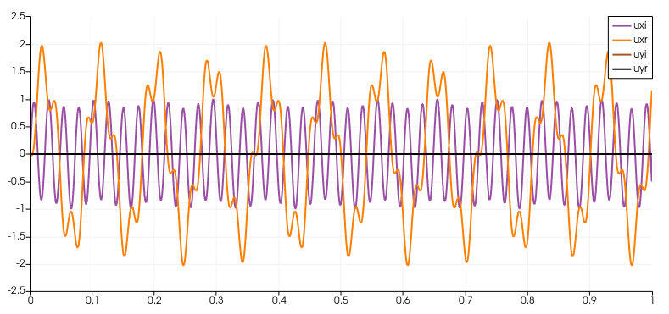
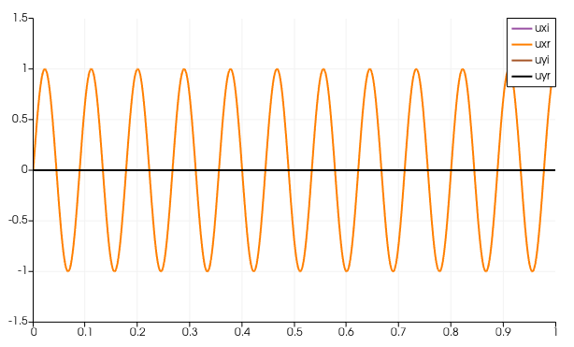
W=100 cycle,
Rho=1

Slide 8
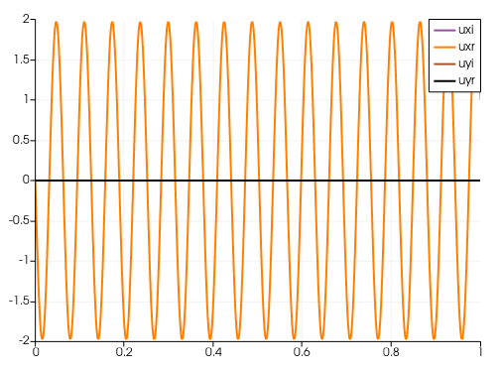
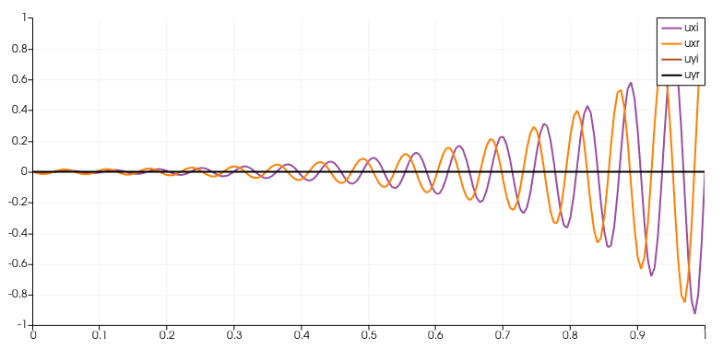

Slide 9
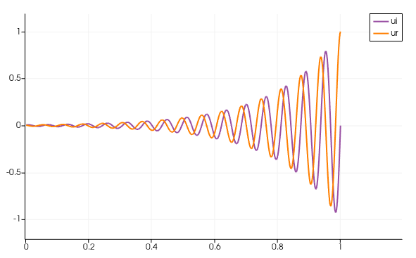

Slide 10
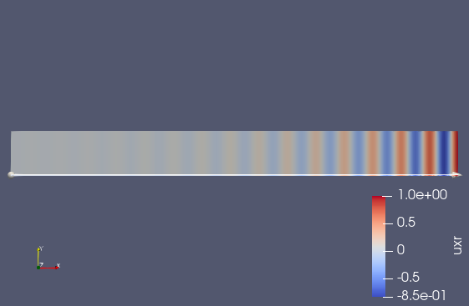
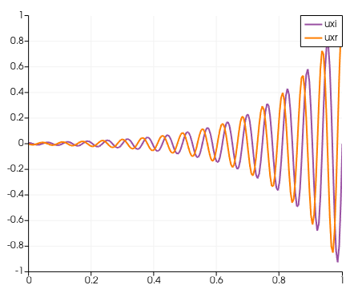

Slide 11
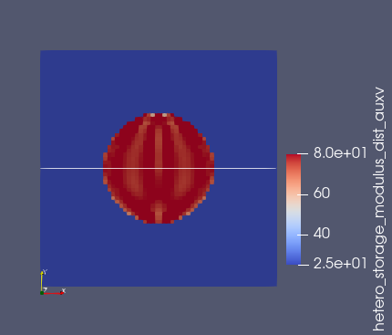
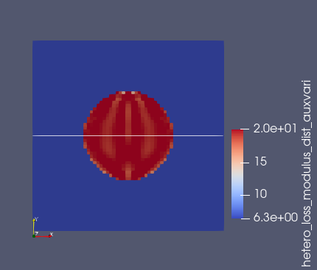
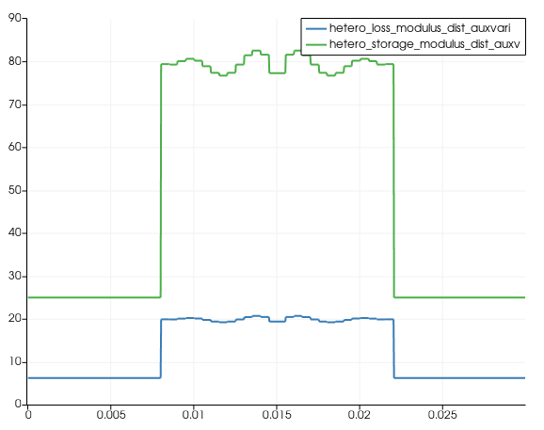
Incompressibe viscoelastic wave equation inversion
Input data
1 source @ (0.015,0.024)
Receivers: 44 RCV@0.005.
11 freq @ (w=100-600@50 HZ)
E_matrix=25 (1+i*w/w_bar) kpa
E_inclusion=80 (1+i*w/w_bar) kpa , w_bar=15000
Initial_guess inclusion=50 (1+i*w/w_bar) kpa
Diameter=0.014=14 mm
Domain= 0.03x0.03= 30 mmx30 mm
Mesh =60x60
Only one component of the wavefield is considered (Ux)
Reconstructed storage modulus
Reconstructed loss modulus @600HZ
Horizontal section cut - Elastic and viscoelastic modulus at @ 600 HZ
Convergence behavior-CC functional

Slide 12
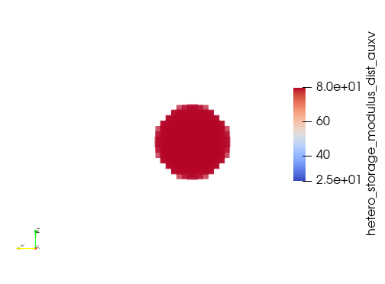
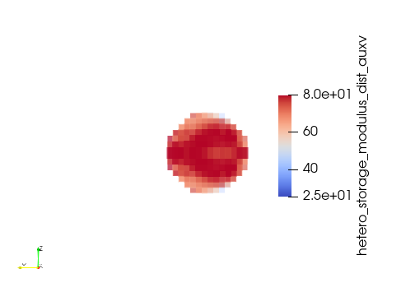
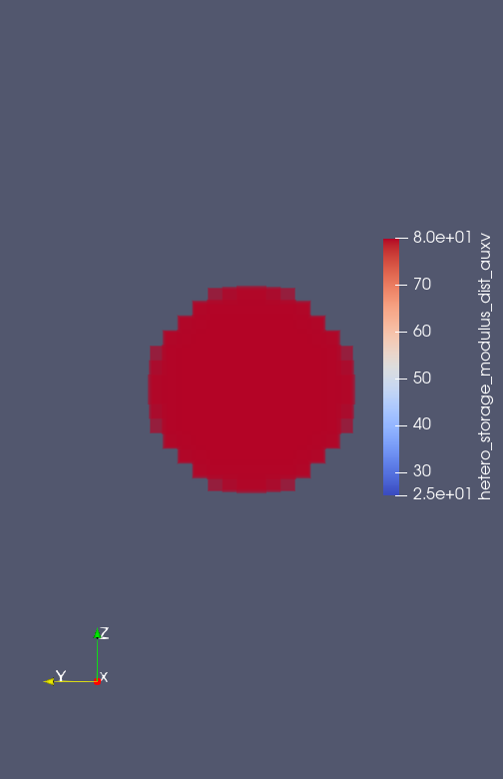
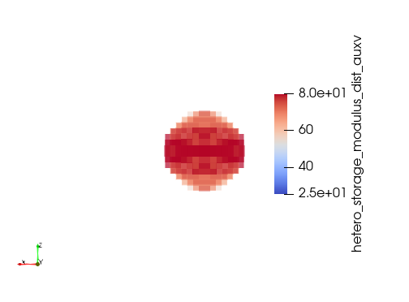
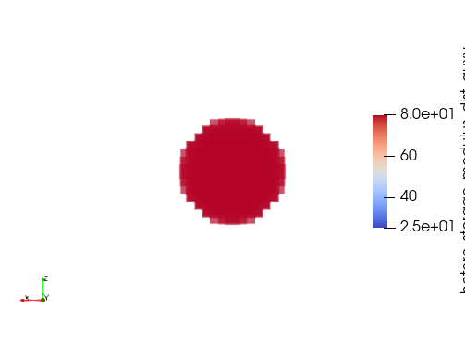
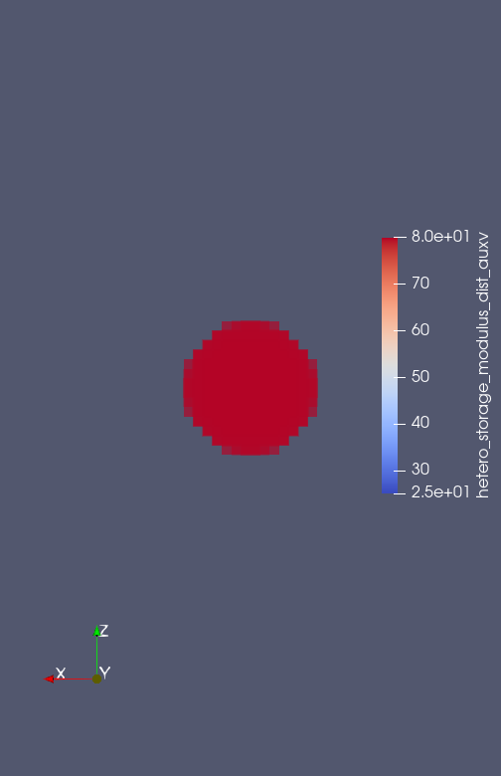
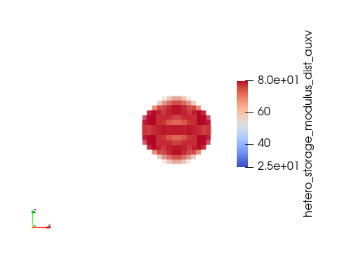

3D Incompressibe viscoelastic wave equation inversion
Input data
1 source @ (0.015,0.024,0.015)
Receivers: 713 RCV (sampled on vertical plane where
top_right_point = '0.03 0.022 0.015'
bottom_left_point = '0.0 0.0 0.015‘)
9 freq @ (w=100-500@50 HZ)
E_matrix=25 (1+i*w/w_bar) kpa
E_inclusion=80 (1+i*w/w_bar) kpa , w_bar=15000
Initial_guess inclusion=50 (1+i*w/w_bar) kpa
Diameter=0.014=14 mm
Domain= 0.03x0.03= 30 mmx30 mm
Mesh =30x30x30
Only one component of the wavefield is considered (Ux)
Storage modulus reconstruction

Slide 13
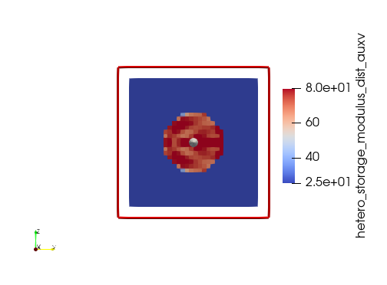
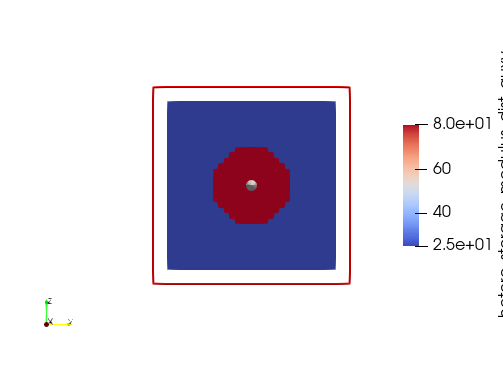
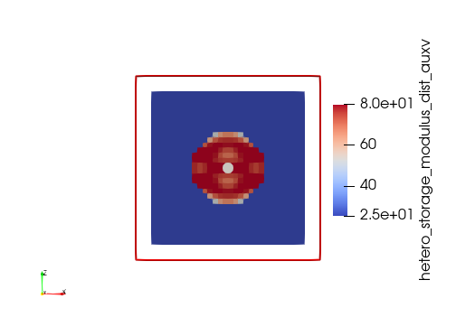
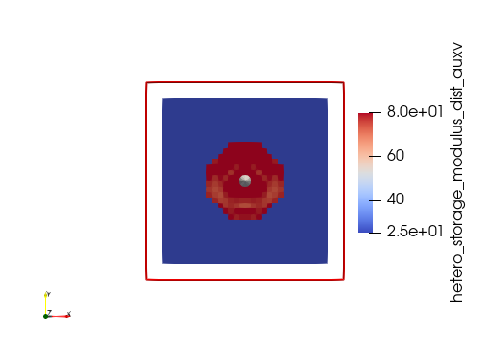
All origin is at the center
Unit normal in x direction
Unit normal in y direction
Unit normal in z direction
Storage modulus reconstruction

Slide 14
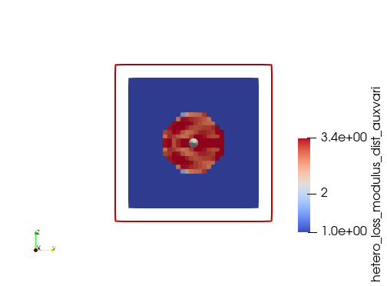
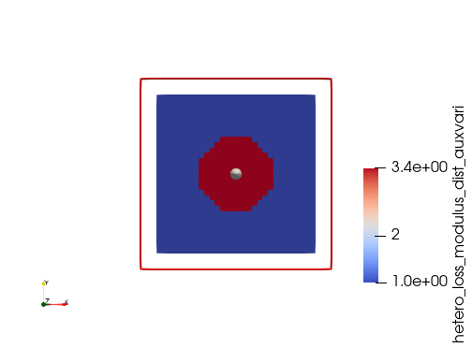
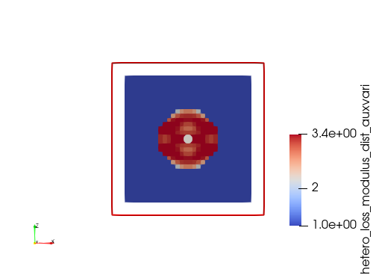
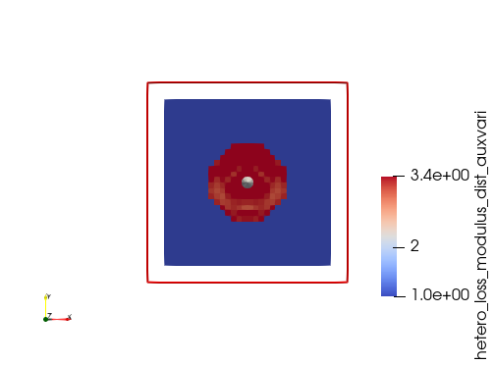
Unit normal in x direction
Unit normal in y direction
Unit normal in z direction
Loss modulus reconstruction @100Hz

Slide 15
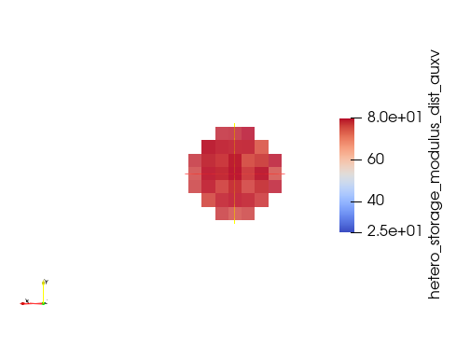
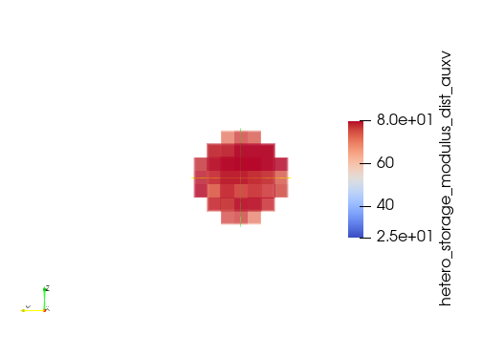
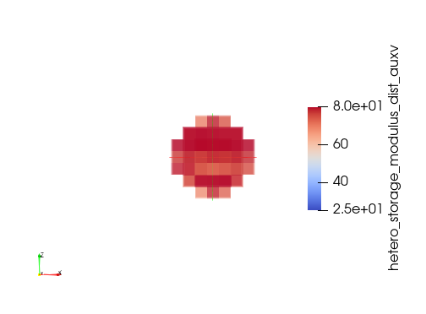
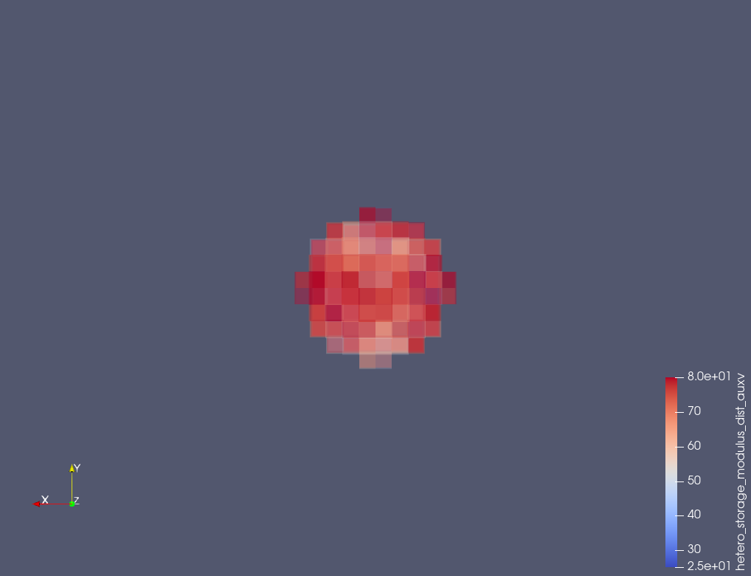
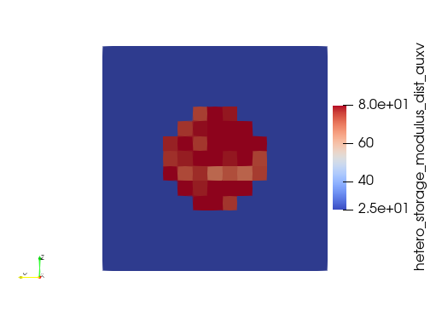
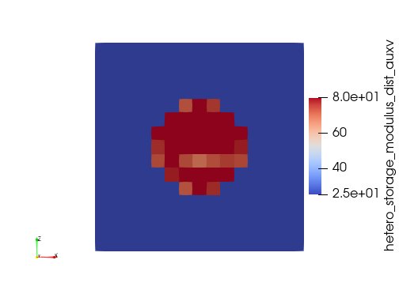
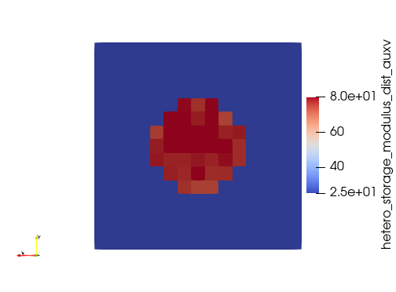
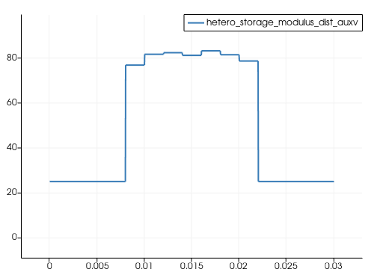
3D Incompressibe viscoelastic wave equation inversion
Input data
Domain= 0.03x0.03= 30 mmx30 mm
Mesh =15x15x15
1 source @ (0.014 0.024 0.014)
Receivers: 176 RCV (sampled on vertical plane where
top_right_point = '0.03 0.02 0.016'
bottom_left_point = '0.0 0.0 0.016‘)
5 freq @ (freq=100-300@50 HZ)
E_matrix=25 (1+i*w/w_bar) kpa
E_inclusion=80 (1+i*w/w_bar) kpa , w_bar=15000
Initial_guess inclusion=50 (1+i*w/w_bar) kpa
Only one component of the wavefield is considered (Ux)
Sampling line:
point1= '0.0 0.015 0.0115'
point2 = '0.3 0.15 0.015‘)

Slide 16







3D Incompressibe viscoelastic wave equation inversion
Input data
Noise : AWGN= 30dB
Domain= 0.03x0.03= 30 mmx30 mm
Mesh =15x15x15
1 source @ (0.014 0.024 0.014)
Receivers: 176 RCV (sampled on vertical plane where
top_right_point = '0.03 0.02 0.016'
bottom_left_point = '0.0 0.0 0.016‘)
5 freq @ (freq=100-300@50 HZ)
E_matrix=25 (1+i*w/w_bar) kpa
E_inclusion=80 (1+i*w/w_bar) kpa , w_bar=15000
Initial_guess inclusion=50 (1+i*w/w_bar) kpa
Only one component of the wavefield is considered (Ux)
Sampling line:
point1= '0.0 0.015 0.0115'
point2 = '0.3 0.15 0.015‘)

Slide 17







3D Incompressibe viscoelastic wave equation inversion
Input data
Noise : AWGN= 20dB
Domain= 0.03x0.03= 30 mmx30 mm
Mesh =15x15x15
1 source @ (0.014 0.024 0.014)
Receivers: 176 RCV (sampled on vertical plane where
top_right_point = '0.03 0.02 0.016'
bottom_left_point = '0.0 0.0 0.016‘)
5 freq @ (freq=100-300@50 HZ)
E_matrix=25 (1+i*w/w_bar) kpa
E_inclusion=80 (1+i*w/w_bar) kpa , w_bar=15000
Initial_guess inclusion=50 (1+i*w/w_bar) kpa
Only one component of the wavefield is considered (Ux)
Sampling line:
point1= '0.0 0.015 0.0115'
point2 = '0.3 0.15 0.015‘)

Slide 18







3D Incompressibe viscoelastic wave equation inversion
Input data
Noise : AWGN= 10dB
Domain= 0.03x0.03= 30 mmx30 mm
Mesh =15x15x15
1 source @ (0.014 0.024 0.014)
Receivers: 176 RCV (sampled on vertical plane where
top_right_point = '0.03 0.02 0.016'
bottom_left_point = '0.0 0.0 0.016‘)
5 freq @ (freq=100-300@50 HZ)
E_matrix=25 (1+i*w/w_bar) kpa
E_inclusion=80 (1+i*w/w_bar) kpa , w_bar=15000
Initial_guess inclusion=50 (1+i*w/w_bar) kpa
Only one component of the wavefield is considered (Ux)
Sampling line:
point1= '0.0 0.015 0.0115'
point2 = '0.3 0.15 0.015‘)

Slide 19







3D Incompressibe viscoelastic wave equation inversion
Input data
Noise : AWGN= 10dB
Domain= 0.03x0.03= 30 mmx30 mm
Mesh =15x15x15
1 source @ (0.014 0.024 0.014)
Receivers: 176 RCV (sampled on vertical plane where
top_right_point = '0.03 0.02 0.016'
bottom_left_point = '0.0 0.0 0.016‘)
11 freq @ (freq=100-300@20 HZ)
E_matrix=25 (1+i*w/w_bar) kpa
E_inclusion=80 (1+i*w/w_bar) kpa , w_bar=15000
Initial_guess inclusion=50 (1+i*w/w_bar) kpa
Only one component of the wavefield is considered (Ux)
Sampling line:
point1= '0.0 0.015 0.0115'
point2 = '0.3 0.15 0.015‘)

Slide 20







3D Incompressibe viscoelastic wave equation inversion
Input data
Noise : AWGN= 10dB
Domain= 0.03x0.03= 30 mmx30 mm
Mesh =20x20x20
1 source @ (0.015 0.024 0.015)
Receivers: 315 RCV (sampled on vertical plane where
top_right_point = '0.03 0.021 0.0165'
bottom_left_point = '0.0 0.0 0.0165’)
10 freq @ (freq=100-480@40 HZ)
E_matrix=25 (1+i*w/w_bar) kpa
E_inclusion=80 (1+i*w/w_bar) kpa , w_bar=15000
Initial_guess inclusion=50 (1+i*w/w_bar) kpa
Only one component of the wavefield is considered (Ux)
Sampling line:
point1= '0.0 0.015 0.0115'
point2 = '0.3 0.15 0.015‘)

Slide 21


2D Incompressibe viscoelastic wave equation inversion
Input data
Domain= 0.03x0.03= 30 mmx30 mm
Mesh =60x60
1 source @ (0.015 0.024)
Receivers: 40 RCV (sampled on vertical a line @ x=15mm
16 freq @ (freq=100-475@25 HZ)
E_matrix=25 +i*25*w/w_bar) kpa
E_inclusion=80+i*80*w/w_bar) kpa ,
w_bar=15000
Initial_guess inclusion=30+i*30*w/w_bar) kpa
Only one component of the wavefield is considered (Ux)
Parameterization: G= G_r +iG_i *w/w_bar
Both G_r and G_i are the parameters to be inverted.

Slide 22


[kpa]

Slide 23



Slide 24

Urban PWE (2021)
Shear moduli: (8.33,26.66) kPa for background and inclusion
Inclusion diameter: (4.05,6.49,10.4)mm – cylindrical
ROI: 16x16 mm2
They also used 20 mm diameter – spherical with ROI 30x30
Fmin-Fmax: 500-1500Hz
Cloutier (2017)
Viscosity (0.4-1.14) Pa.s for background and inclusion

Slide 25


Cloutier (2014)
Viscosity: (0.1-1.5) Pa.s for background and inclusion
Shea elasticity: (5-20) kPa for background and inclusion

Slide 26

Fink (2005) – values measured by MRI

Slide 27


Slide 28





Slide 29



2D Incompressibe viscoelastic wave equation inversion
Input data
Domain= 0.03x0.03= 30 mmx30 mm
Mesh =60x60
Push @ (0.015 0.024)
Receivers: 40 RCV (sampled on vertical a line @ x=15mm
16 freq @ (freq=100-475@25 HZ)
Viscoelastic model: Kelvin-Voigt
$E$= $15+9∗sin⁡(70∗pi∗((0.03−x)^2/0.03))∗sin⁡(80∗pi∗(y))$ kPa
$η=3$ Pa.s (known)
Invert only for $E$
Initial guess $E$= $15$kPa
Only one component of the wavefield is considered (Ux)

Slide 30


2D Incompressibe viscoelastic wave equation inversion
Input data
Domain= 0.03x0.03= 30 mmx30 mm
Mesh =60x60
Push @ (0.015 0.024)
Receivers: 40 RCV (sampled on vertical a line @ x=15mm
16 freq @ (freq=100-475@25 HZ)
Viscoelastic model: Kelvin-Voigt
$E$= $15+9∗sin⁡(70∗pi∗((0.03−x)^2/0.03))∗sin⁡(80∗pi∗(y))$ kPa
$$η=7.5+4.5∗sin⁡(70∗pi∗((0.03−y)^2/0.03+x))∗sin⁡(80∗pi∗((0.03−x)^2/0.03+y)) (known)$$
Invert only for $E$
Initial guess $E$= $15$kPa
Only one component of the wavefield is considered (Ux)

Slide 31


2D Incompressibe viscoelastic wave equation inversion
Input data
Domain= 0.03x0.03= 30 mmx30 mm
Mesh =60x60
Push @ (0.015 0.024)
Receivers: 61 RCV (sampled on vertical a line @ x=15mm
16 freq @ (freq=100-475@25 HZ)
Viscoelastic model: Kelvin-Voigt
$E$= $15+9∗sin⁡(70∗pi∗((0.03−x)^2/0.03))∗sin⁡(80∗pi∗(y))$ kPa
$$η(true)=7.5+4.5∗sin\left(70∗pi∗\left(\frac{{\left(0.03−y\right)}^{2}}{0}.03+x\right)\right)∗sin\left(80∗pi∗\left(\frac{{\left(0.03−x\right)}^{2}}{0}.03+y\right)\right)$$
$η(forward)=7.5$ (known)
Invert only for $E$
Initial guess $E$= $15$kPa
Only one component of the wavefield is considered (Ux)
Notice that the image is symmetric around the rcv line whereas it is not in the ground truth. This may be a result of assuming homogenous young’s modulus as initial guess, and known homogenous viscosity.
Also notice the large error in region surrounds the push. This is always happening!

Slide 32


2D Incompressibe viscoelastic wave equation inversion
Input data
Domain= 0.03x0.03= 30 mmx30 mm
Mesh =60x60
Push @ (0.015 0.024)
Receivers: 44 RCV (sampled on vertical a line @ x=15mm
12 freq @ (freq=125-400@25 HZ)
Viscoelastic model: Kelvin-Voigt
$E$= $15+9∗sin⁡(70∗pi∗((0.03−x)^2/0.03))∗sin⁡(80∗pi∗(y))$ kPa
$$η(true)=7.5+4.5∗sin\left(70∗pi∗\left(\frac{{\left(0.03−y\right)}^{2}}{0}.03+x\right)\right)∗sin\left(80∗pi∗\left(\frac{{\left(0.03−x\right)}^{2}}{0}.03+y\right)\right)$$
$η(forward)=7.5$ (known)
Invert only for $E$
Initial guess $E$= $15$kPa
Only one component of the wavefield is considered (Ux)

Slide 33


2D Incompressibe viscoelastic wave equation inversion
Input data
Domain= 0.03x0.03= 30 mmx30 mm
Mesh =60x60
Push @ (0.015 0.024)
Receivers: 40 RCV (sampled on vertical a line @ x=15mm
14 freq @ (freq=125-450@25 HZ)
Viscoelastic model: Kelvin-Voigt
$E$= $15+9∗sin⁡(70∗pi∗((0.03−x)^2/0.03))∗sin⁡(80∗pi∗(y))$ kPa
$$η(true)=7.5+4.5∗sin\left(70∗pi∗\left(\frac{{\left(0.03−y\right)}^{2}}{0}.03+x\right)\right)∗sin\left(80∗pi∗\left(\frac{{\left(0.03−x\right)}^{2}}{0}.03+y\right)\right)$$
$η\left(forward\right)=η\left(true\right)$(known)
Invert only for $log(E)$
Initial guess $E$= $15$kPa
Only one component of the wavefield is considered (Ux)

Slide 34


2D Incompressibe viscoelastic wave equation inversion
Input data
Domain= 0.03x0.03= 30 mmx30 mm
Mesh =60x60
Push @ (0.015 0.024)
Receivers: 40 RCV (sampled on vertical a line @ x=15mm
16 freq @ (freq=100-475@25 HZ)
Viscoelastic model: Kelvin-Voigt
$E$= $15+9∗sin⁡(70∗pi∗((0.03−x)^2/0.03))∗sin⁡(80∗pi∗(y))$ kPa
$$η(true)=7.5+4.5∗sin\left(70∗pi∗\left(\frac{{\left(0.03−y\right)}^{2}}{0}.03+x\right)\right)∗sin\left(80∗pi∗\left(\frac{{\left(0.03−x\right)}^{2}}{0}.03+y\right)\right)$$
$η(forward)=7.5$ (known)
Invert only for $log(E)$
Initial guess $E$= $15$kPa
Only one component of the wavefield is considered (Ux)

Slide 35


Group1
Acquisition in middle and freq=[100-475 @ 25Hz]
Group2
Acquisition @ x=8 mm, and freq=[100-200 @10HZ]
After 5 iter
After 50 iter
Does wrong viscosity confuse the inversion? Try use true viscosity

Slide 36








Simultaneous inversion of 2 acquisition2
2D Incompressibe viscoelastic wave equation inversion
Input data
Domain= 0.03x0.03= 30 mmx30 mm
Mesh =60x60
Push @ (0.015 0.024)
Receivers: 40 RCV (sampled on vertical a line @ x=15mm
14 freq @ (freq=125-450@25 HZ)
Viscoelastic model: Kelvin-Voigt
$E$= $15+9∗sin⁡(70∗pi∗((0.03−x)^2/0.03))∗sin⁡(80∗pi∗(y))$ kPa
$$η(true)=7.5+4.5∗sin\left(70∗pi∗\left(\frac{{\left(0.03−y\right)}^{2}}{0}.03+x\right)\right)∗sin\left(80∗pi∗\left(\frac{{\left(0.03−x\right)}^{2}}{0}.03+y\right)\right)$$
$η\left(forward\right)=η\left(true\right)$(known)
Invert only for $log(E)$
Initial guess $E$= $15$kPa
Only one component of the wavefield is considered (Ux)

Slide 37


